Slide 1
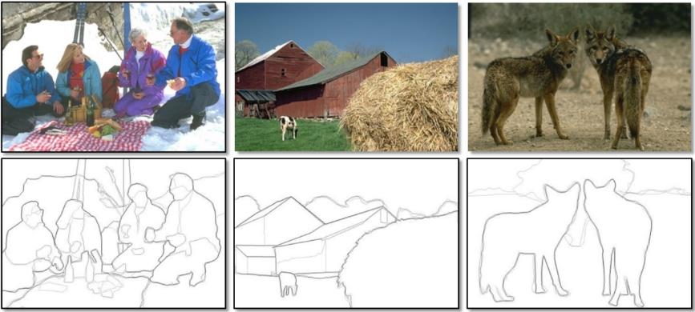
Edge Detection
Computer Vision
Jia-Bin Huang, Virginia Tech
Many slides from D. Hoiem and K. Grauman

Slide 2
Administrative Stuffs
Questions about HW?
Ask me/TA after classes
Post questions on Piazza (no emails)
Attend office hours

Slide 3
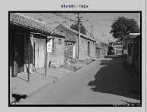
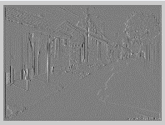
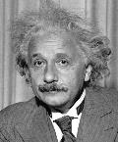
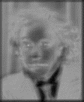

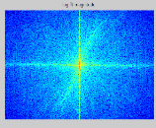
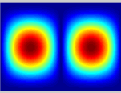
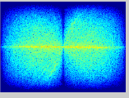
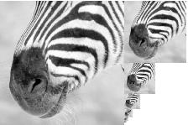
Previous three classes: Image Filtering
Spatial domain
Smoothing, sharpening, measuring texture
Template matching
Find a template in an image
*
=
FFT
FFT
Inverse FFT
Image pyramid
Coarse-to-fine search
Multi-scale detection
=
Frequency domain
Denoising, sampling, image compression

Slide 4
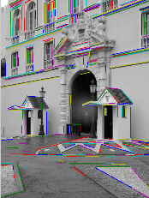
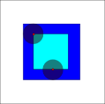
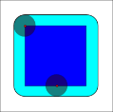
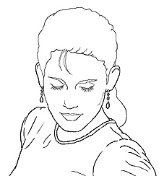
Today’s class
Detecting edges
Finding straight lines
Binary image analysis

Slide 5
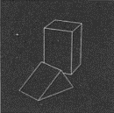
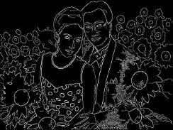
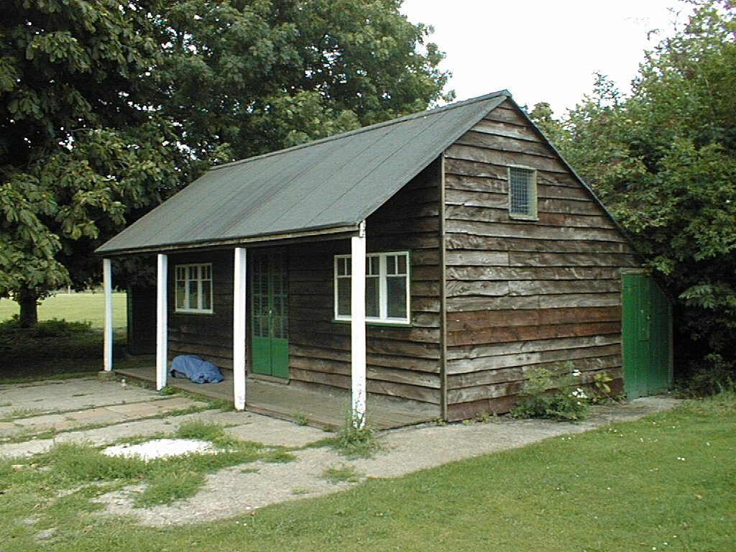
Why finding edges is important?
Cues for 3D shape
Group pixels into objects or parts
Guiding interactive image editing
Recover geometry and viewpoint
Vertical vanishing
point
(at infinity)
Vanishing
line
Vanishing
point
Vanishing
point

Slide 6
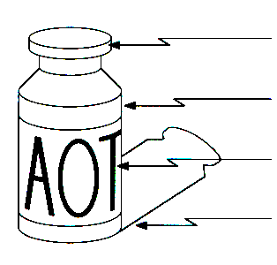
Origin of Edges
surface normal discontinuity
depth discontinuity
surface color discontinuity
illumination discontinuity
Edges are caused by a variety of factors
Source: Steve Seitz

Slide 7
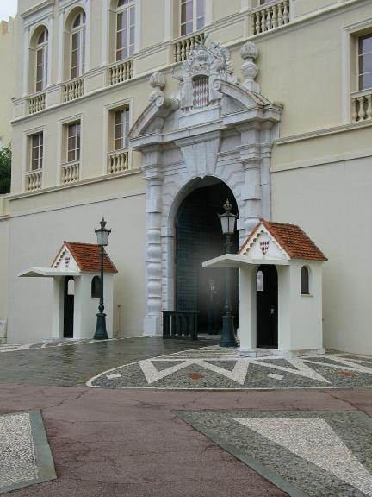
Closeup of edges

Slide 8

Closeup of edges

Slide 9

Closeup of edges

Slide 10
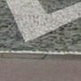
Closeup of edges

Slide 11

Characterizing edges
An edge is a place of rapid change in the image intensity function
intensity function (along horizontal scanline)
image
first derivative
edges correspond to extrema of derivative

Slide 12
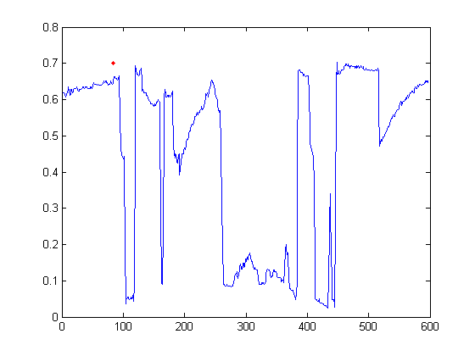
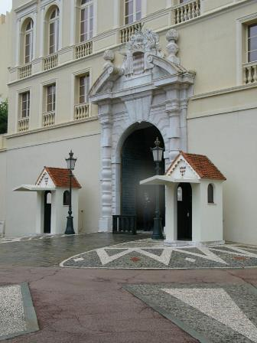
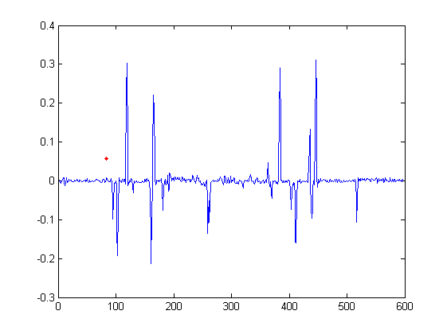
Intensity profile
Intensity
Gradient

Slide 13
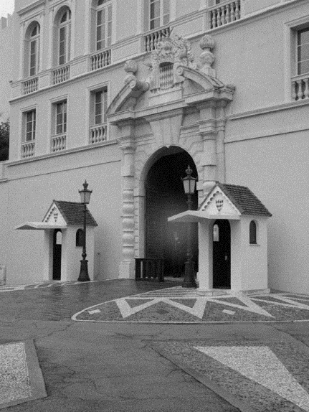
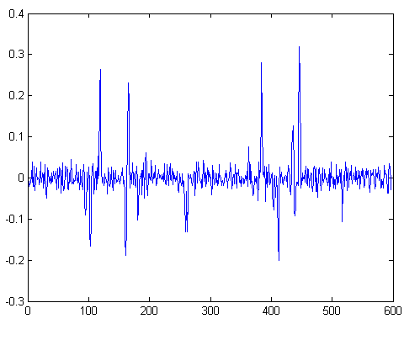
With a little Gaussian noise
Gradient

Slide 14
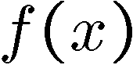
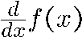
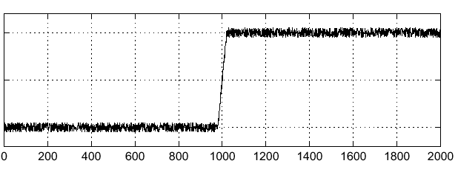
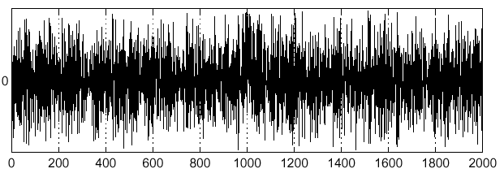
Effects of noise
Consider a single row or column of the image
Plotting intensity as a function of position gives a signal
Where is the edge?
Source: S. Seitz
Notes:
How to fix?

Slide 15
Effects of noise
Difference filters respond strongly to noise
Image noise results in pixels that look very different from their neighbors
Generally, the larger the noise the stronger the response
What can we do about it?
Source: D. Forsyth

Slide 16
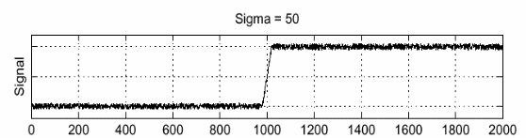
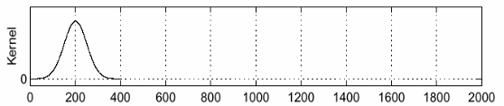
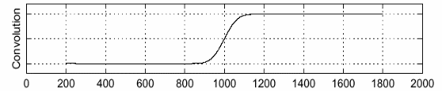
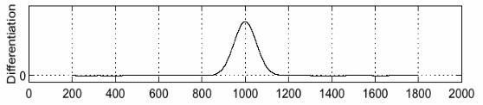
Solution: smooth first
f
g
f * g
To find edges, look for peaks in
Source: S. Seitz

Slide 17
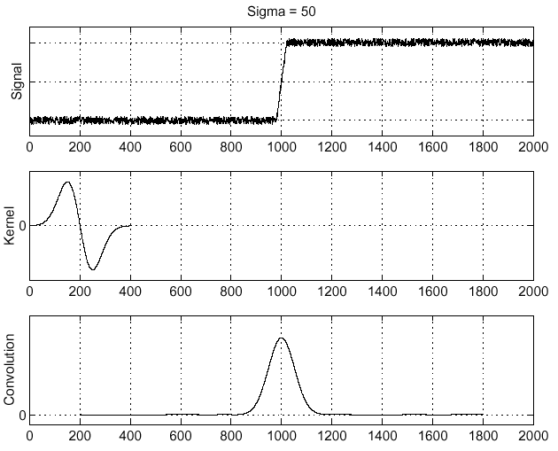
Derivative theorem of convolution
Differentiation is convolution, and convolution is associative:
This saves us one operation:
f
Source: S. Seitz

Slide 18
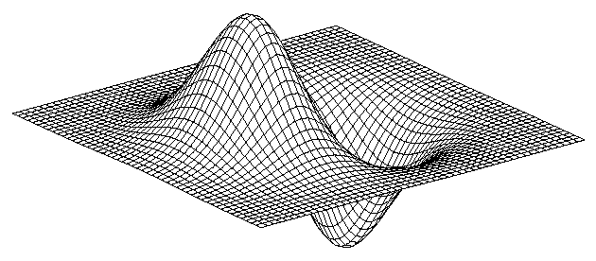
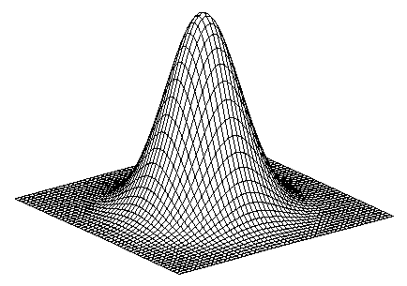
Derivative of Gaussian filter
* [1 0 -1] =
Is this filter separable?

Slide 19
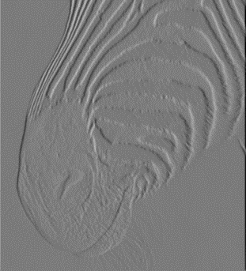
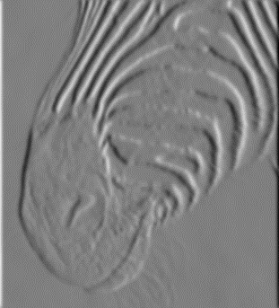
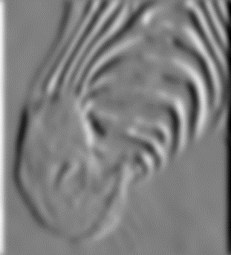
Tradeoff between smoothing and localization
1 pixel
3 pixels
7 pixels
Smoothed derivative removes noise, but blurs edge. Also finds edges at different “scales”.
Source: D. Forsyth

Slide 20
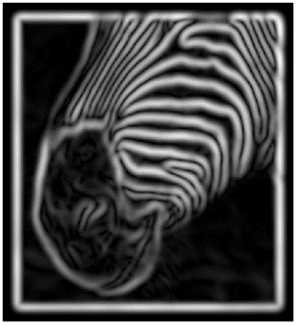
Implementation issues
The gradient magnitude is large along a thick “trail” or “ridge,” so how do we identify the actual edge points?
How do we link the edge points to form curves?
Source: D. Forsyth
Notes:
Figures show gradient magnitude of zebra at two different scales

Slide 21
Designing an edge detector
Criteria for a good edge detector:
Good detection:
find all real edges, ignoring noise or other artifacts
Good localization
detect edges as close as possible to the true edges
return one point only for each true edge point
Cues of edge detection
Differences in color, intensity, or texture across the boundary
Continuity and closure
High-level knowledge
Source: L. Fei-Fei

Slide 22

Canny edge detector
The most widely used edge detector
Theoretical model:
step-edges corrupted by additive Gaussian noise
The first derivative of the Gaussian closely approximates the operator that optimizes the product of signal-to-noise ratio and localization
J. Canny, A Computational Approach To Edge Detection, IEEE Trans. Pattern Analysis and Machine Intelligence, 8:679-714, 1986.
Source: L. Fei-Fei

Slide 23

Example
input image (“Lena”)

Slide 24
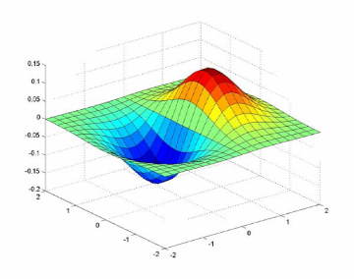
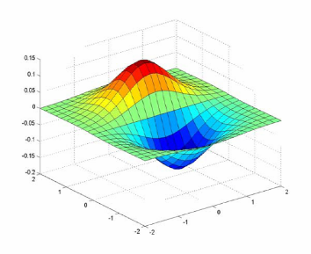
Derivative of Gaussian filter
x-direction
y-direction

Slide 25
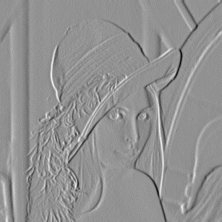
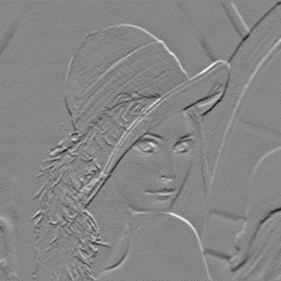
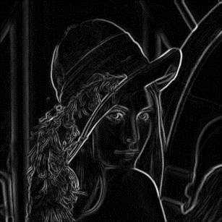
Compute Gradients (DoG)
X-Derivative of Gaussian
Y-Derivative of Gaussian
Gradient Magnitude

Slide 26
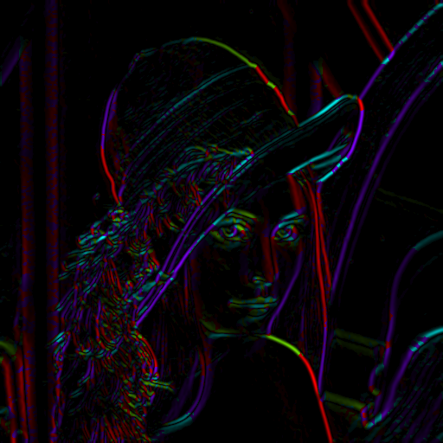
Get Orientation at Each Pixel
Threshold at minimum level
Get orientation
theta = atan2(-gy, gx)
Notes:
-gy because y=2 is below y=1, and we typically want 90 degrees to point up

Slide 27


Non-maximum suppression for each orientation
At q, we have a maximum if the value is larger than those at both p and at r. Interpolate to get these values.
Source: D. Forsyth

Slide 28
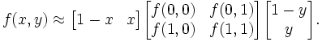
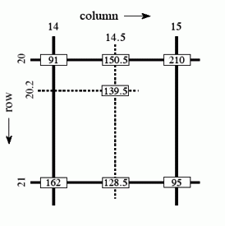
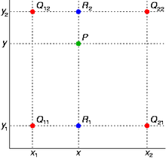
Bilinear Interpolation
http://en.wikipedia.org/wiki/Bilinear_interpolation

Slide 29
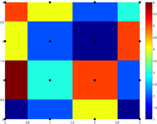
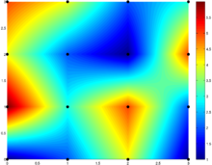

Sidebar: Interpolation options
imx2 = imresize(im, 2, interpolation_type);
‘nearest’
Copy value from nearest known
Very fast but creates blocky edges
‘bilinear’
Weighted average from four nearest known pixels
Fast and reasonable results
‘bicubic’ (default)
Non-linear smoothing over larger area
Slower, visually appealing, may create negative pixel values
Examples from http://en.wikipedia.org/wiki/Bicubic_interpolation

Slide 30

Before Non-max Suppression

Slide 31

After non-max suppression

Slide 32

Hysteresis thresholding
Threshold at low/high levels to get weak/strong edge pixels
Do connected components, starting from strong edge pixels

Slide 33
Hysteresis thresholding
Check that maximum value of gradient value is sufficiently large
drop-outs? use hysteresis
use a high threshold to start edge curves and a low threshold to continue them.
Source: S. Seitz

Slide 34


Final Canny Edges

Slide 35
Canny edge detector
Filter image with x, y derivatives of Gaussian
Find magnitude and orientation of gradient
Non-maximum suppression:
Thin multi-pixel wide “ridges” down to single pixel width
Thresholding and linking (hysteresis):
Define two thresholds: low and high
Use the high threshold to start edge curves and the low threshold to continue them
MATLAB: edge(image, ‘canny’)
Source: D. Lowe, L. Fei-Fei

Slide 36




Effect of σ (Gaussian kernel spread/size)
original
Canny with
Canny with
The choice of σ depends on desired behavior
large σ detects large scale edges
small σ detects fine features
Source: S. Seitz

Slide 37






Learning to detect boundaries
image
human segmentation
gradient magnitude
Berkeley segmentation database: http://www.eecs.berkeley.edu/Research/Projects/CS/vision/grouping/segbench/

Slide 38

pB boundary detector
Martin, Fowlkes, Malik 2004: Learning to Detection Natural Boundaries…
Figure from Fowlkes

Slide 39

pB Boundary Detector
Figure from Fowlkes

Slide 40

Brightness
Color
Texture
Combined
Human

Slide 41



Results
Pb (0.88)
Human (0.95)

Slide 42



Results
Pb
Pb (0.88)
Global Pb
Human
Human (0.96)

Slide 43



Pb (0.63)
Human (0.95)

Slide 44



Pb (0.35)
Human (0.90)
For more: http://www.eecs.berkeley.edu/Research/Projects/CS/vision/bsds/bench/html/108082-color.html

Slide 45

Global pB boundary detector
Figure from Fowlkes

Slide 46
Edge Detection with Structured Random Forests (Dollar and Zitnick ICCV 2013)
Goal: quickly predict whether each pixel is an edge
Insights
Predictions can be learned from training data
Predictions for nearby pixels should not be independent
Solution
Train structured random forests to split data into patches with similar boundaries based on features
Predict boundaries at patch level, rather than pixel level, and aggregate (average votes)
Boundaries in patch
http://research.microsoft.com/pubs/202540/DollarICCV13edges.pdf

Slide 47

Edge Detection with Structured Random Forests - Algorithm
Extract overlapping 32x32 patches at three scales
Features are pixel values and pairwise differences in feature maps (LUV color, gradient magnitude, oriented gradient)
Predict $T$ boundary maps in the central 16x16 region using $T$ trained decision trees
Average predictions for each pixel across all patches

Slide 48
Edge Detection with Structured Random Forests - Results
BSDS 500
NYU Depth dataset edges

Slide 49
Edge Detection with Structured Random Forests
Ground truth
Results (multiscale)

Slide 50
Crisp Boundary Detection using Pointwise Mutual Information (Isola et al. ECCV 2014)
Pixel combinations that are unlikely to be together are edges
Algorithm:
Kernel density estimation
Spectral clustering
http://web.mit.edu/phillipi/www/publications/crisp_boundaries.pdf

Slide 51
Crisp Boundary Detection using Pointwise Mutual Information

Slide 52

Holistically-Nested Edge Detection
Xie and Tu, Holistically-Nested Edge Detection, ICCV 2015

Slide 53

Holistically-Nested Edge Detection
Xie and Tu, Holistically-Nested Edge Detection, ICCV 2015

Slide 54
State of edge detection
Local edge detection is mostly solved
Intensity gradient, color, texture
Work on RGB-D edge detection is currently more active
Some methods take into account longer contours, but could probably do better
Often used in combination with object detectors or region classifiers

Slide 55

Finding straight lines

Slide 56
Finding line segments using connected components
Compute canny edges
Compute: gx, gy (DoG in x,y directions)
Compute: theta = atan(gy / gx)
Assign each edge to one of 8 directions
For each direction d, get edgelets:
find connected components for edge pixels with directions in {d-1, d, d+1}
Compute straightness and theta of edgelets using eig of x,y 2nd moment matrix of their points
Threshold on straightness, store segment
Larger eigenvector

Slide 57

Canny lines → … →straight edges

Slide 58








Binary images
Slide credit: Kristen Grauman

Slide 59
Binary image analysis: basic steps
Convert the image into binary form
Thresholding
Clean up the thresholded image
Morphological operators
Extract separate blobs
Connected components
Describe the blobs with region properties
Slide credit: Kristen Grauman

Slide 60


Binary images
Two pixel values
Foreground and background
Mark region(s) of interest
Slide credit: Kristen Grauman

Slide 61



Thresholding
Grayscale -> binary mask
Useful if object of interest’s intensity distribution is distinct from background
Example http://homepages.inf.ed.ac.uk/rbf/CVonline/LOCAL_COPIES/FITZGIBBON/simplebinary.html
Slide credit: Kristen Grauman

Slide 62


Thresholding
Given a grayscale image or an intermediate matrix → threshold to create a binary output.
Example: edge detection
Gradient magnitude
fg_pix = find(gradient_mag > t);
Looking for pixels where gradient is strong.
Slide credit: Kristen Grauman

Slide 63




Thresholding
Given a grayscale image or an intermediate matrix → threshold to create a binary output.
Example: background subtraction
-
=
Looking for pixels that differ significantly from the “empty” background.
Slide credit: Kristen Grauman
fg_pix = find(diff > t);

Slide 64


Thresholding
Given a grayscale image or an intermediate matrix → threshold to create a binary output.
Example: intensity-based detection
fg_pix = find(im < 65);
Looking for dark pixels
Slide credit: Kristen Grauman

Slide 65


Thresholding
Given a grayscale image or an intermediate matrix → threshold to create a binary output.
Example: color-based detection
fg_pix = find(hue > t1 & hue < t2);
Looking for pixels within a certain hue range.
Slide credit: Kristen Grauman

Slide 66


A nice case: bimodal intensity histograms
Ideal histogram, light object on dark background
Actual observed histogram with noise
Images: http://homepages.inf.ed.ac.uk/rbf/CVonline/LOCAL_COPIES/OWENS/LECT2/node3.html
Slide credit: Kristen Grauman

Slide 67



Not so nice cases
Slide credit: Shapiro and Stockman

Slide 68

Issues
What to do with “noisy” binary outputs?
Holes
Extra small fragments
How to demarcate multiple regions of interest?
Count objects
Compute further features per object
Slide credit: Kristen Grauman

Slide 69
Morphological operators
Change the shape of the foreground regions via intersection/union operations between a scanning structuring element and binary image.
Useful to clean up result from thresholding
Basic operators are:
Dilation
Erosion
Slide credit: Kristen Grauman

Slide 70


Dilation
Expands connected components
Grow features
Fill holes
Before dilation
After dilation
Slide credit: Kristen Grauman
Notes:
Disk strel, 5 pixels wide

Slide 71


Erosion
Erode connected components
Shrink features
Remove bridges, branches, noise
Before erosion
After erosion
Slide credit: Kristen Grauman

Slide 72


Structuring elements
Masks of varying shapes and sizes used to perform morphology, for example:
Scan mask across foreground pixels to transform the binary image
>> help strel
Slide credit: Kristen Grauman

Slide 73
Dilation vs. Erosion
At each position:
Dilation: if current pixel is foreground, OR the structuring element with the input image.
Slide credit: Kristen Grauman

Slide 74
Example for Dilation
Input image
1 | 0 | 0 | 0 | 1 | 1 | 1 | 0 | 1 | 1
Structuring
Element
1
1
1
Output Image
1 | 1
Slide credit: Adapted by Kristen Grauman from T. Moeslund

Slide 75
Example for Dilation
Input image
1 | 0 | 0 | 0 | 1 | 1 | 1 | 0 | 1 | 1
Structuring Element
1
1
1
Output Image
1 | 1
Slide credit: Kristen Grauman

Slide 76
Example for Dilation
Input image
1 | 0 | 0 | 0 | 1 | 1 | 1 | 0 | 1 | 1
Structuring Element
1
1
1
Output Image
1 | 1 | 0
Slide credit: Kristen Grauman

Slide 77
Example for Dilation
Input image
1 | 0 | 0 | 0 | 1 | 1 | 1 | 0 | 1 | 1
Structuring Element
1
1
1
Output Image
1 | 1 | 0 | 1
Slide credit: Kristen Grauman

Slide 78
Example for Dilation
Input image
1 | 0 | 0 | 0 | 1 | 1 | 1 | 0 | 1 | 1
Structuring Element
1
1
1
Output Image
1 | 1 | 0 | 1 | 1 | 1
Slide credit: Kristen Grauman

Slide 79
Example for Dilation
Input image
1 | 0 | 0 | 0 | 1 | 1 | 1 | 0 | 1 | 1
Structuring Element
1
1
1
Output Image
1 | 1 | 0 | 1 | 1 | 1 | 1
Slide credit: Kristen Grauman

Slide 80
Example for Dilation
Input image
1 | 0 | 0 | 0 | 1 | 1 | 1 | 0 | 1 | 1
Structuring Element
1
1
1
Output Image
1 | 1 | 0 | 1 | 1 | 1 | 1 | 1
Slide credit: Kristen Grauman

Slide 81
Example for Dilation
Input image
1 | 0 | 0 | 0 | 1 | 1 | 1 | 0 | 1 | 1
Structuring Element
1
1
1
Output Image
1 | 1 | 0 | 1 | 1 | 1 | 1 | 1
Slide credit: Kristen Grauman

Slide 82
Example for Dilation
Input image
1 | 0 | 0 | 0 | 1 | 1 | 1 | 0 | 1 | 1
Structuring Element
1
1
1
Output Image
1 | 1 | 0 | 1 | 1 | 1 | 1 | 1 | 1 | 1
Note that the object gets bigger and holes are filled.
>> help imdilate
Slide credit: Kristen Grauman

Slide 83

2D example for dilation

Slide 84
Dilation vs. Erosion
At each position:
Dilation: if current pixel is foreground, OR the structuring element with the input image.
Erosion: if every pixel under the structuring element’s nonzero entries is foreground, OR the current pixel with S.
Slide credit: Kristen Grauman

Slide 85
Example for Erosion (1D)
Input image
1 | 0 | 0 | 0 | 1 | 1 | 1 | 0 | 1 | 1
1
1
1
Structuring Element
_
Output Image
0
Slide credit: Kristen Grauman

Slide 86
Example for Erosion (1D)
Input image
1 | 0 | 0 | 0 | 1 | 1 | 1 | 0 | 1 | 1
1
1
1
Structuring Element
_
Output Image
0 | 0
Slide credit: Kristen Grauman

Slide 87
Example for Erosion
Input image
1 | 0 | 0 | 0 | 1 | 1 | 1 | 0 | 1 | 1
Structuring Element
1
1
1
Output Image
0 | 0 | 0
Slide credit: Kristen Grauman

Slide 88
Example for Erosion
Input image
1 | 0 | 0 | 0 | 1 | 1 | 1 | 0 | 1 | 1
Structuring Element
1
1
1
Output Image
0 | 0 | 0 | 0
Slide credit: Kristen Grauman

Slide 89
Example for Erosion
Input image
1 | 0 | 0 | 0 | 1 | 1 | 1 | 0 | 1 | 1
Structuring Element
1
1
1
Output Image
0 | 0 | 0 | 0 | 0
Slide credit: Kristen Grauman

Slide 90
Example for Erosion
Input image
1 | 0 | 0 | 0 | 1 | 1 | 1 | 0 | 1 | 1
Structuring Element
1
1
1
Output Image
0 | 0 | 0 | 0 | 0 | 1
Slide credit: Kristen Grauman

Slide 91
Example for Erosion
Input image
1 | 0 | 0 | 0 | 1 | 1 | 1 | 0 | 1 | 1
Structuring Element
1
1
1
Output Image
0 | 0 | 0 | 0 | 0 | 1 | 0
Slide credit: Kristen Grauman

Slide 92
Example for Erosion
Input image
1 | 0 | 0 | 0 | 1 | 1 | 1 | 0 | 1 | 1
Structuring Element
1
1
1
Output Image
0 | 0 | 0 | 0 | 0 | 1 | 0 | 0
Slide credit: Kristen Grauman

Slide 93
Example for Erosion
Input image
1 | 0 | 0 | 0 | 1 | 1 | 1 | 0 | 1 | 1
Structuring Element
1
1
1
Output Image
0 | 0 | 0 | 0 | 0 | 1 | 0 | 0 | 0
Slide credit: Kristen Grauman

Slide 94
Example for Erosion
Input image
1 | 0 | 0 | 0 | 1 | 1 | 1 | 0 | 1 | 1
Structuring Element
1
1
1
Output Image
0 | 0 | 0 | 0 | 0 | 1 | 0 | 0 | 0 | 1
Note that the object gets smaller
>> help imerode
Slide credit: Kristen Grauman

Slide 95

2D example for erosion

Slide 96

Opening
First erode, then dilate
Remove small objects, keep original shape
Before opening
After opening
Slide credit: Kristen Grauman

Slide 97

Closing
First dilate, then erode
Fill holes, but keep original shape
Before closing
After closing
Applet: http://bigwww.epfl.ch/demo/jmorpho/start.php
Slide credit: Kristen Grauman

Slide 98



Morphology operators on grayscale images
Dilation and erosion typically performed on binary images.
If image is grayscale:
Diation: take the neighborhood MAX
Erosion: take the neighborhood MIN
original
dilated
eroded
Slide credit: Kristen Grauman

Slide 99
Issues
What to do with “noisy” binary outputs?
Holes
Extra small fragments
How to demarcate multiple regions of interest?
Count objects
Compute further features per object
Slide credit: Kristen Grauman

Slide 100


Connected components
Identify distinct regions of “connected pixels”
Slide credit: Shapiro and Stockman

Slide 101

Connectedness
Defining which pixels are considered neighbors
4-connected
8-connected
Slide credit: Chaitanya Chandra

Slide 102

Connected components
We’ll consider a sequential algorithm that requires only 2 passes over the image.
Input: binary image
Output: “label” image, where pixels are numbered per their component
Note: foreground here is denoted with black pixels.
Slide credit: Kristen Grauman

Slide 103

Sequential connected components
Slide credit: Adapted by Kristen Grauman from J. Neira

Slide 104
Sequential connected components
Slide credit: Kristen Grauman

Slide 105
Sequential connected components
Slide credit: Kristen Grauman

Slide 106

Sequential connected components
Slide credit: Kristen Grauman

Slide 107

Connected components
Slide credit: Pinar Duygulu

Slide 108


Region properties
Given connected components, can compute simple features per blob, such as:
Area (num pixels in the region)
Centroid (average x and y position of pixels in the region)
Bounding box (min and max coordinates)
Circularity (ratio of mean dist. to centroid over std)
A2=170
A1=200
Slide credit: Kristen Grauman

Slide 109

Circularity
[Haralick]
Slide credit: Shapiro & Stockman

Slide 110
Binary image analysis: basic steps (recap)
Convert the image into binary form
Thresholding
Clean up the thresholded image
Morphological operators
Extract separate blobs
Connected components
Describe the blobs with region properties
Slide credit: Kristen Grauman

Slide 111
Matlab
N = hist(Y,M);
L = bwlabel (BW,N);
STATS = regionprops(L,PROPERTIES) ;
'Area'
'Centroid'
'BoundingBox'
'Orientation‘, …
IM2 = imerode(IM,SE);
IM2 = imdilate(IM,SE);
IM2 = imclose(IM, SE);
IM2 = imopen(IM, SE);
Slide credit: Kristen Grauman

Slide 112

Example using binary image analysis: OCR
[Luis von Ahn et al. http://recaptcha.net/learnmore.html]
Slide credit: Kristen Grauman

Slide 113

Example using binary image analysis: segmentation of a liver
Slide credit: Li Shen

Slide 114
Binary images
Pros
Can be fast to compute, easy to store
Simple processing techniques available
Lead to some useful compact shape descriptors
Cons
Hard to get “clean” silhouettes
Noise common in realistic scenarios
Can be too coarse of a representation
Not 3d
Slide credit: Kristen Grauman

Slide 115









Things to remember
Canny edge detector = smooth → derivative → thin → threshold → link
Pb: learns weighting of gradient, color, texture differences More recent learning approaches give at least as good accuracy and are faster
Straight line detector = canny + gradient orientations → orientation binning → linking → check for straightness
Binary image analysis thresholding, dialation, erosion

Slide 116



Next classes: Correspondence and Alignment
Detecting interest points
Tracking points
Object/image alignment and registration
Aligning 3D or edge points
Object instance recognition
Image stitching

Slide 117


